Slide 1

Property Listing Analysis
- Sandeep Phatak
- Vidyashree C M

Slide 2
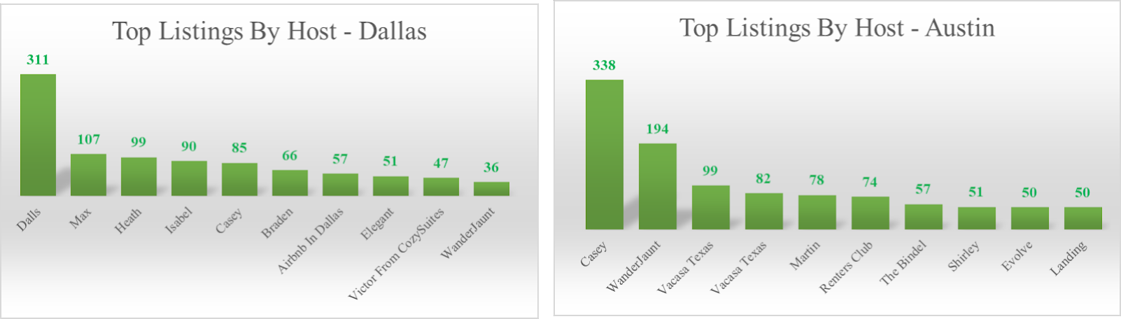
Hosts with higher number of Listings

Slide 3
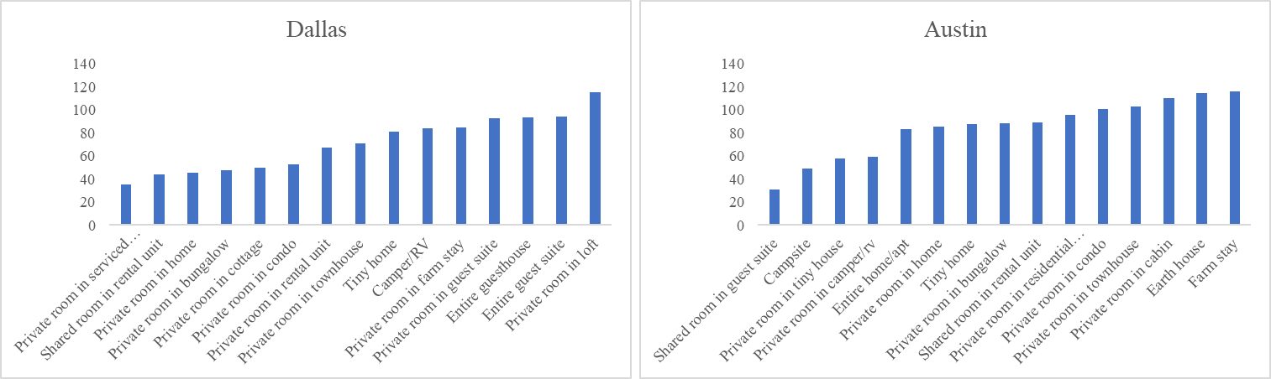
Average Price of Instant bookable, higher ratings

Slide 4
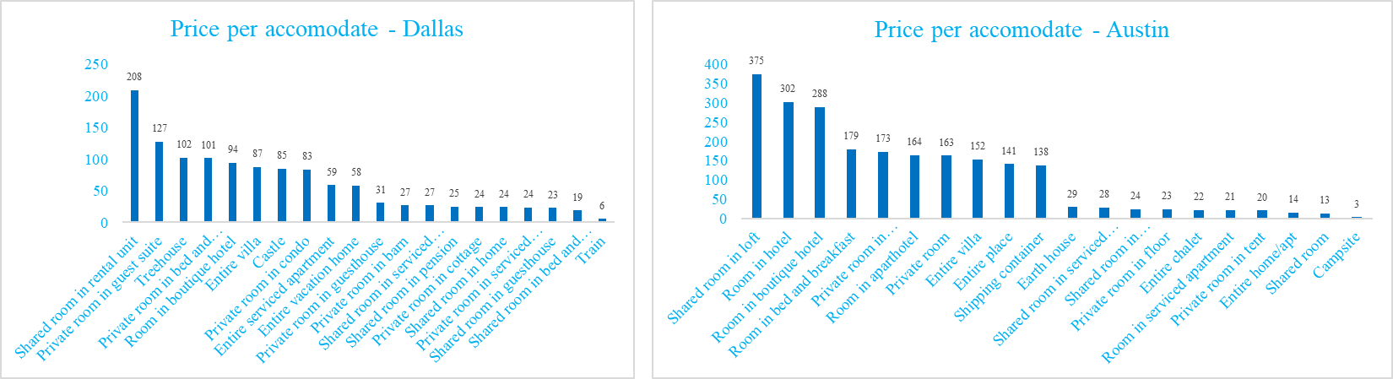
Price per accommodate for each property type

Slide 5
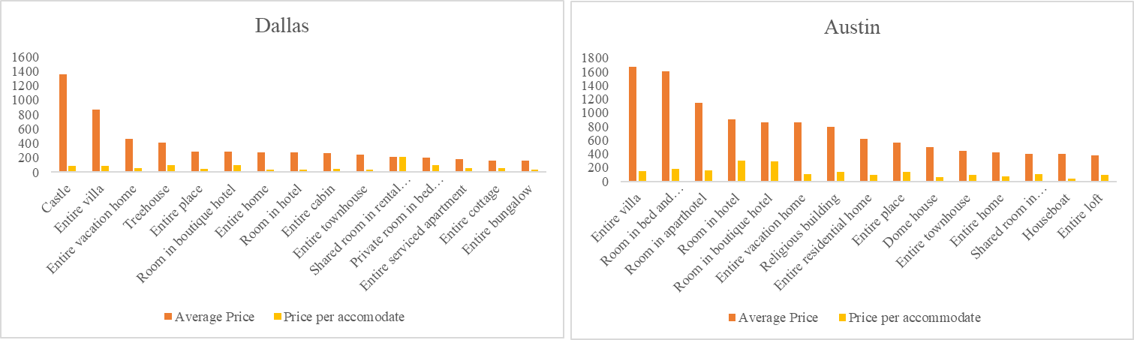
Average price v/s price per accommodate

Slide 6
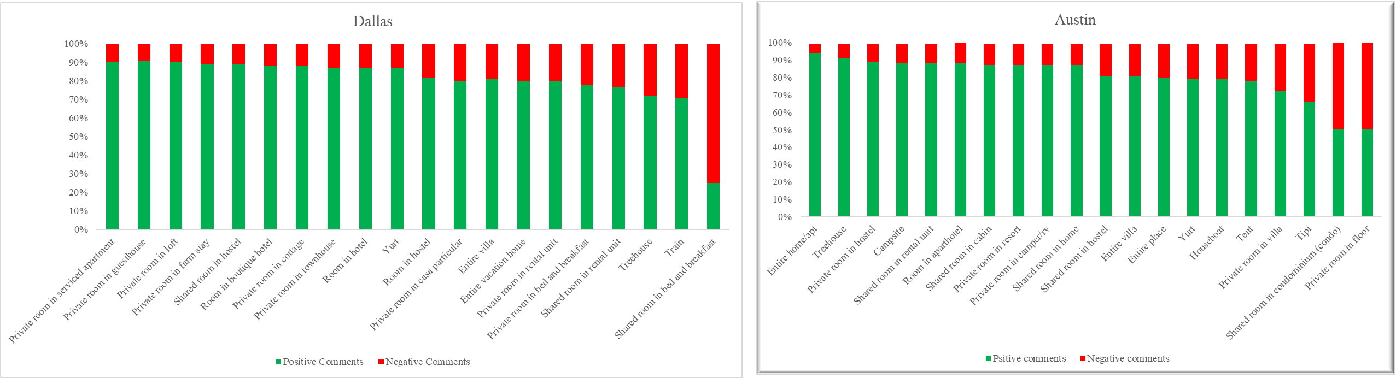
Property-wise positive and negative comments

Slide 7
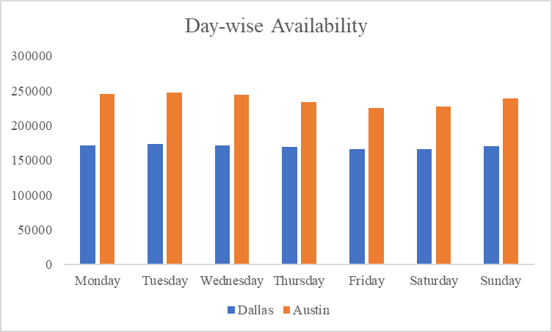
Day-wise availability of listings

Slide 8
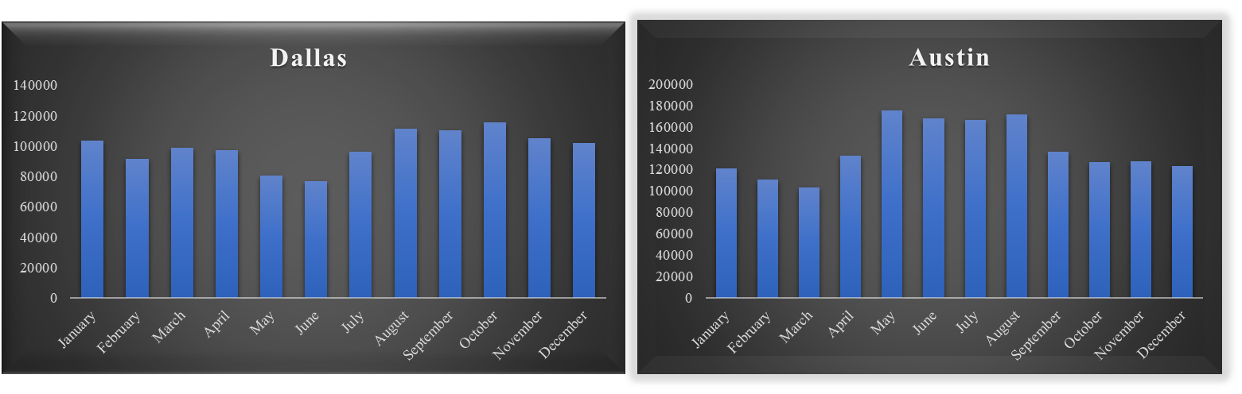
Month-wise availability of listings

Slide 9
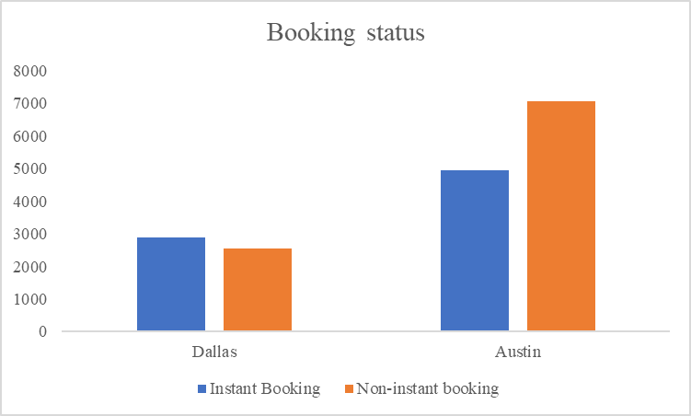
Instant v/s non-instant bookable listings

Slide 10

Thank you

